Slide 1
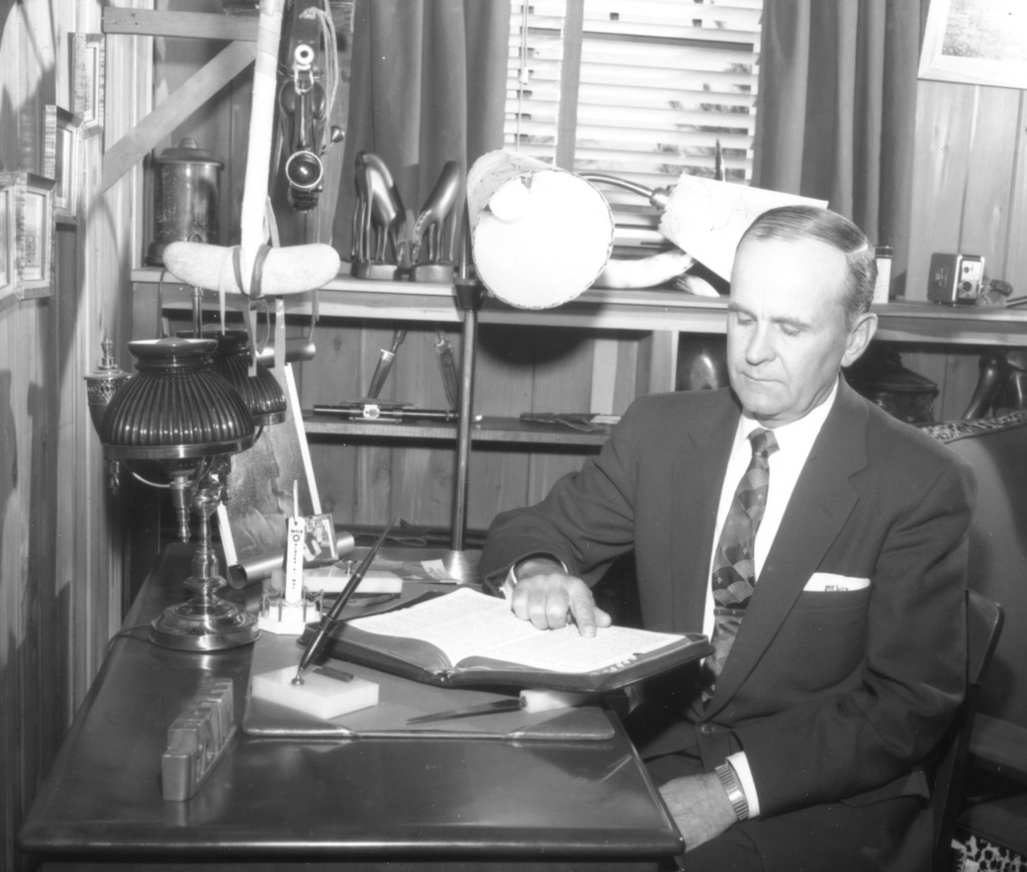
Living Prophecy So, What is the Mark of the Beast?
#3

Slide 2
ANNOUNCEMENTS
Sunday Services will now
@ 10AM
Wednesday Services will remain
@ 7PM for now

Slide 3
REMINDERS
Respect in the Sanctuary
Restroom before service
Please do not bring food and drinks into the sanctuary

Slide 4
TONIGHT 1.) What is the Mark of the Beast? 2.) What is the Seal of God? 3.) What is the Sea of Glass?

Slide 5
REVELATION 13 : 17
. . . cannot buy or sell . . .

Slide 6
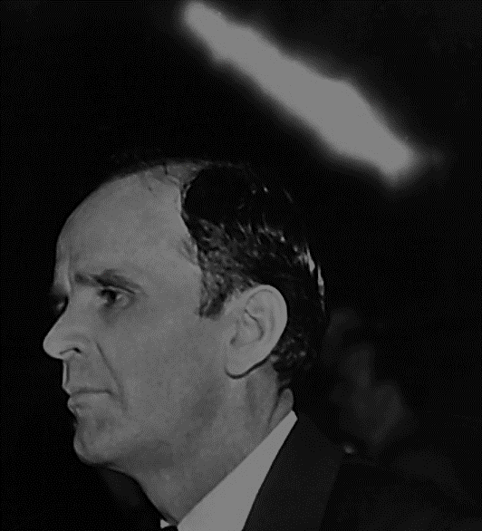
60-1211M The Ten Virgins, And The Hundred And Forty-Four Thousand Jews
309 Well, they’re…And how many was on earth that didn’t get It? “All that was not sealed took the mark of the beast.” All, that had not the Spirit of God, had the mark of the beast.

Slide 7
60-1211M The Ten Virgins, And The Hundred And Forty-Four Thousand Jews
… The Seal of God is the Holy Spirit. The Bible said so. Every place in the Scripture speaks of It, says It’s the Mark of God, “the Seal of God.” And all that did not have It, was one who reject It. And how did they reject It? By refusing to hear It. Is that right?

Slide 8
61-0217 The Mark Of The Beast And The Seal Of God #2
221 What is the mark of the beast? To reject the Holy Ghost, see, the borderline, see, after he once come to the knowledge of the truth. …

Slide 9
61-0217 The Mark Of The Beast And The Seal Of God #2
“For it is impossible for those which were once enlightened,” see, coming up to the knowledge of the truth, and seeing that they see the truth, and see the knowledge of it, and see it’s here, see it working, see it’s right, and have a knowledge of the truth, and then turn away again, “there remaineth no more sacrifice for sin.”

Slide 10
REVELATION 14 : 9 - 11
. . . warning of judgement for those with the mark of the beast . . .

Slide 11
REVELATION 4 : 5 - 6
. . . Sea of Glass . . .

Slide 12
REVELATION 15 : 2 - 4
. . . Those who have GOTTEN victory over the beast . . .

Slide 13
61-0108 Revelation, Chapter Four Part III
190 How do we come? We’ve got to come (this Gentile Church) to this Word, sea of glass, water, water of the Word (Is that right?), recognize the Word the way It’s written.

Slide 14
61-0108 Revelation, Chapter Four Part III
Then the sacrifice is received and filled with the Holy Ghost from the inside, shining through the Light of that age.

Slide 15
61-0108 Revelation, Chapter Four Part III
191 Notice, now, at the end of this age, John, when he saw the sea of brass there, it was “clear as crystal.” What was it? The Word had been taken from the earth, raptured in the Church, and it was “clear as crystal,” no more Blood, the Church age was over.

Slide 16
61-0108 Revelation, Chapter Four Part III
192 Now, in Revelation 15, the remnant of the woman’s Seed, which was the Tribulation saints that went through the Tribulation, was found (Look!) standing on this sea. And it was filled with fire, blood, red blazes licking forth, the fire of God.

Slide 17
61-0108 Revelation, Chapter Four Part III
They had gotten the victory over the beast (Rome), over his number, over the letter of his name, and over his image (the Confederation of Churches), and had come out.

Slide 18
61-0108 Revelation, Chapter Four Part III
And through the preaching of Moses and Elijah, those two prophets that will appear to Israel to pull out the…this group of people, those Tribulation Period saints, back in that time that’ll be brought in, was…

Slide 19
61-0108 Revelation, Chapter Four Part III
193 See, the Church is done raptured now, but remember the Wife is on the Throne. The Tribulation Period…Lived in the kingdoms, out, and brought all of their kings and their honor and glory into the City.

Slide 20
61-0108 Revelation, Chapter Four Part III
As we get down into Revelation 22, you’ll see it. If you’re writing this out and holding it, when we get to it you’ll see what we mean. We haven’t got time to just catch every little thing and run it back and forth, but hit the high spots of it. Then someday, maybe, the Lord willing, we’ll have a lot of time to talk of it.

Slide 21
61-0108 Revelation, Chapter Four Part III
194 Now, these Tribulation Period saints that come up, had went through great tribulations. (The Church will not go through the Tribulation! Do you see they was already in Glory?)

Slide 22
61-0108 Revelation, Chapter Four Part III
And here’s the Tribulation saints, the sanctified ones that had…being it’s mine and your fault they had never heard the Word. If they heard It and rejected It, they went on to hell; they was cast out into outer darkness because they rejected the Word. But if they would never heard It, God is just, Tribulation Period comes to them.

Slide 23
61-0108 Revelation, Chapter Four Part III
195 Now, notice just a minute. Saints washed by the same Word, ’cause it’s the same altar, it’s the same sea of glass and the same Word. Revelation 2:5, Revelation 15: (or rather) :2 to :5. Notice, just a minute.

Slide 24
61-0108 Revelation, Chapter Four Part III
Now, we never took the Word to them, that’s the reason they was—they was like that. We never took the Word to them, we’re going to be held responsible. So we’ll not be able to catch all the peoples; the Church won’t (in this age) that’s got the Truth.

Slide 25
61-0108 Revelation, Chapter Four Part III
Because they’ll go through the Tribulation, they’re not the Saints that died way back yonder in them church ages, because he said, “They come up out of the great Tribulation,” and the great Tribulation is yet future, after the Church goes Home.

Slide 26
WE JUST COVERED 1.) What is the Mark of the Beast? 2.) What is the Seal of God? 3.) What is the Sea of Glass?

